Slide 1
Heart Disease Prediction Project
Presented By :
[Student’s Name Here]
[Student’s Name Here]

Slide 2
INDEX
Project Overview
Scope
Modules
Development Tools
Pros & Cons
Applications

Slide 3
PROJECT OVERVIEW
A major challenge facing healthcare organizations (hospitals, medical centers) is the provision of quality services at affordable costs. Quality service implies diagnosing patients correctly and administering treatments that are effective. Data mining combines statistical analysis, machine learning and database technology to extract hidden patterns and relationships from large databases. The two most common modeling objectives are classification and prediction. Classification models predict categorical labels (discrete, unordered) while prediction models predict continuous-valued functions. Naive Bayes or Bayes‟ Rule is the basis for many machine-learning and data mining methods. The rule (algorithm) is used to create models with predictive capabilities. It provides new ways of exploring and understanding data. It learns from the “evidence” by calculating the correlation between the target (i.e., dependent) and other (i.e., independent) variables. In Weighted Associative Classifier (WAC), different weights are assigned to different attributes according to their predicting capability.

Slide 4
SCOPE
Naive Bayes or Bayes‟ Rule is the basis for many machine-learning and data mining methods. The rule (algorithm) is used to create models with predictive capabilities. It provides new ways of exploring and understanding data. It learns from the “evidence” by calculating the correlation between the target (i.e., dependent) and other (i.e., independent) variables. In Weighted Associative Classifier (WAC), different weights are assigned to different attributes according to their predicting capability. Weighted Associative Classifier (WAC) is a new concept that uses Weighted Association Rule for classification. Weighted ARM uses Weighted Support and Confidence Framework to extract Association rule from data repository. The WAC has been proposed as a new Technique to get the significant rule instead of flooded with insignificant relation.

Slide 5
MODULES
Admin
Login
Add Training Data
Add Doctor Details
View User Details
View Feedback
View Doc Details
View Doc Details
Students
Register (With Details like Age, Sex, etc.)
Login
Check Heart
System will accordingly view Doctor to consult.
Give Feedback
View Doctor

Slide 6

DEVELOPMENT TOOLS
MICROSOFT VISUAL STUDIO
Microsoft Visual Studio is an integrated development environment (IDE) from Microsoft. It is used to develop computer programs, as well as websites, web apps, web services and mobile apps. Visual Studio supports 36 different programming languages and allows the code editor and debugger to support nearly any programming language.
Features:
1. Code Editor 2. Debugger 3. Designer 4. Extensibility

Slide 7
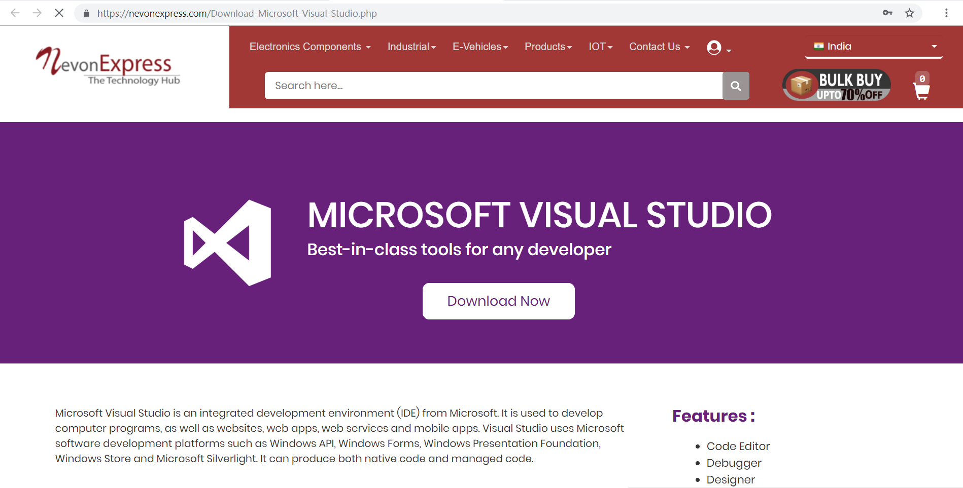
DOWNLOAD MS VISUAL STUDIO
We can get Visual Studio from NevonExpress.com : Visit Here

Slide 8

DEVELOPMENT TOOLS
MICROSOFT SQL SERVER
Microsoft SQL Server is a relational database management system developed by Microsoft. As a database server, it is a software product with the primary function of storing and retrieving data as requested by other. Microsoft markets at least a dozen different editions of Microsoft SQL Server, aimed at different audiences and for workloads.
Features:
1. Least Vulnerable 2. Advanced Analytics 3. Easy-to-Use

Slide 9
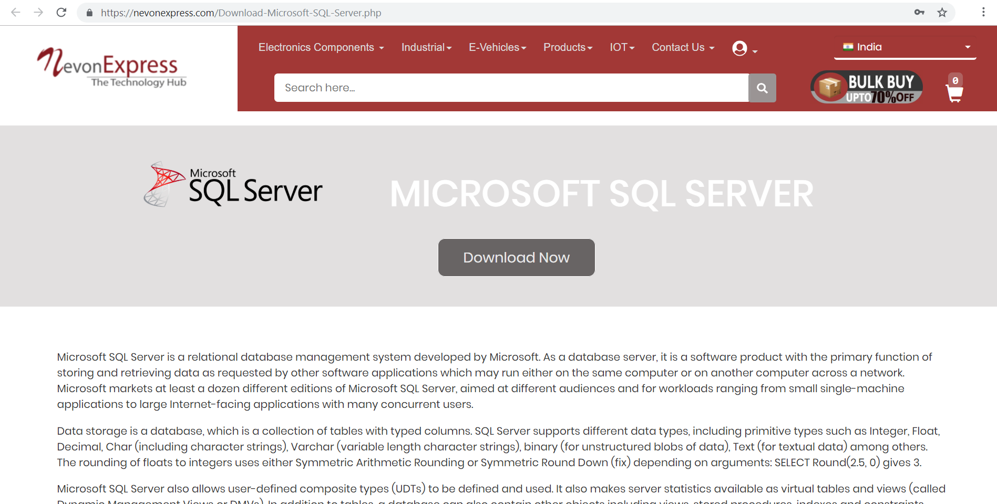
DOWNLOAD MICROSOFT SQL SERVER
We can get SQL Server from NevonExpress.com : Visit Here

Slide 10
PROS & CONS
Advantages
User can search for doctor’s help at any point of time.
User can talk about their Heart Disease and get instant diagnosis.
Doctors get more clients online.
Naive Bayes Algorithm is a fast, highly scalable algorithm.
Very useful in case of emergency.
Disadvantages
The system is not fully automated, it needs data from user for full diagnosis.

Slide 11
APPLICATIONS
This application can be used by all patients or their family members who need help in emergency.

Slide 12
THANK YOU !!!

